Slide 1
Lab 1 C++ Basics & Flow of Control
DEE 1319
Department of Electronics Engineering
National Chiao Tung University

Slide 2
Outline
C++ basics and flow of control reviews
Lab1 exercise

Slide 3
C++ Identifiers
An Identifier is a name of variables constant, …
A C++ identifier
Consists of a sequence of letters, digits, and the underscore character ( _ )
Must start with either a letter or an underscore character // avoid doing so in general
Is case-sensitive
Can be of any length // NOT true in reality
Keywords are special identifiers
E.g., if, for, char, …
Cannot be used for user-defined entities

Slide 4
C++ Variables
Variables
Its name is an identifier
is a memory location to store data
Must be declared before its use int number; // declaration & definition
double width, length; // declaration & definition
extern int count; // declaration ONLY, discuss later
Meaningful names!
Naming convention: starting with a lowercase letter
E.g., weight, total_weight, …

Slide 5
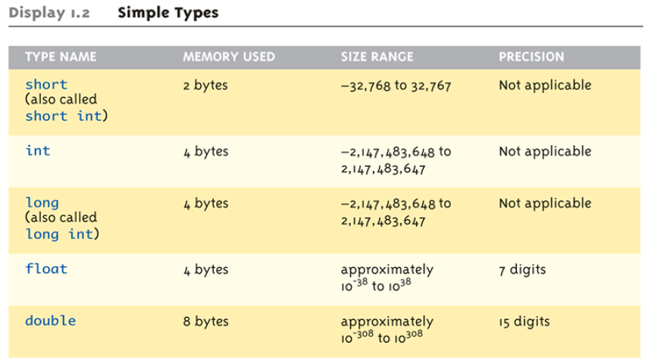
Fundamental Data Types (1/2)

Slide 6
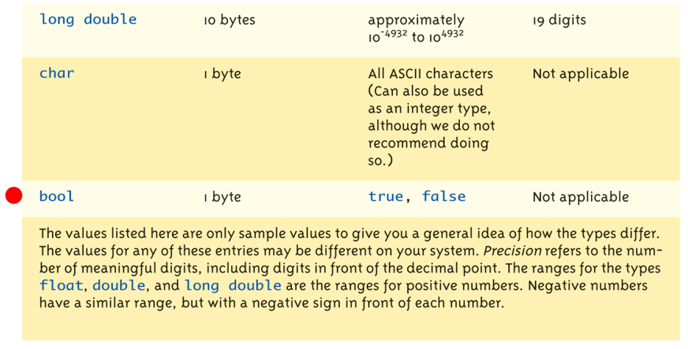
Fundamental Data Types (2/2)

Slide 7
Constants
double money *= (1 + 0.05); //What is 0.05?
const double RATE = 0.05; //all uppercase letters double money *= (1 + RATE); // better readability RATE = 0.1; // compilation error
Named constants or declared constants (e.g., RATE)
Better readability and maintainability
Change attempts result in compilation errors!
Named constants MUST be initialized const int myWeight; // compilation error!

Slide 8
Arithmetic Precision
Examples:
17 / 5 evaluates to 3 in C++!
Both operands are integers (Integer division)
17.0 / 5 equals 3.4 in C++!
Highest-order operand is "double type“ (Double "precision" division)
int intVar1 =1, intVar2=2; intVar1 / intVar2;
Result: 0! (Integer division)
Calculations done "one-by-one“
1 / 2 / 3.0 / 4 performs 3 separate divisions.
First ➔ 1 / 2 equals 0
Then ➔ 0 / 3.0 equals 0.0
Then ➔ 0.0 / 4 equals 0.0!
So not necessarily sufficient to change just "one operand" in a large expression

Slide 9
Type Casting
Casting for Variables
C style
double dvar = (double) ivar;
C++ style
double dvar = static_cast<double>(ivar) ;
static_cast<type>(expression)
Two kinds
implicit — also called “automatic“
done for you automatically 17 / 5.5 casting the 17 ➔ 17.0
explicit type conversion
programmer specifies conversion with static_cast operator int m; static_cast<double>(m) / 5.5

Slide 10
Libraries
C++ standard libraries
Input/output, math, strings, …
#include <Library_Name>
directive to "add" contents of the specified library file to your program
called "preprocessor directive"
Executes before compilation, and simply “copies” library file into your program file

Slide 11
Namespaces
Namespaces defined:
collection of name definitions
#include <iostream> using namespace std;
includes entire standard library of name definitions

Slide 12
Console Input/Output
I/O objects cin for input, cout for output, cerr for error output
Defined in the C++ library called <iostream>
Must have these lines (called pre-processor directives) near start of file:
#include <iostream> using namespace std;
Tells C++ compiler to use appropriate library so we can use the I/O objects cin, cout, cerr

Slide 13
Console Output
Any data can be outputted to display screen
Variables
Constants
Literals
Expressions (which can include all of above)
cout << numberOfGames << " games played.";
“value” of variable numberOfGames and literal string “games played.” are outputted
Cascading: multiple values in one cout
New lines in output
cout << "Hello World\n";
cout << "Hello World" << endl;

Slide 14
Console Input
cin >> num;
waits on-screen for keyboard entry
value entered at keyboard is "assigned" to num
">>" (extraction operator) points opposite
Think of it as "pointing toward where the data goes“
no literals allowed for cin
Must input to a variable
cin >> 23; // compilation error!

Slide 15
Branch Mechanisms
if-else statements
Choice of two mutually exclusive statements based on condition expression
Syntax: if(<Boolean_expression>){ <true_statement> }else{ <false_statement> }

Slide 16
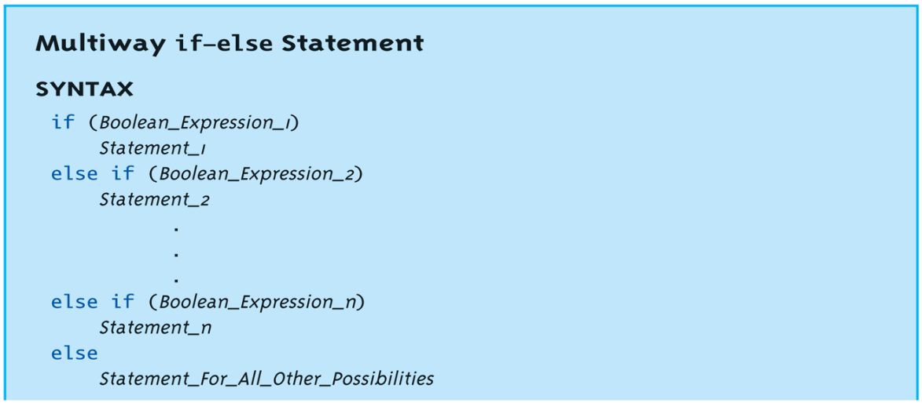
Multiway if-else (1/2)
Avoid “excessive” indenting
Syntax :

Slide 17
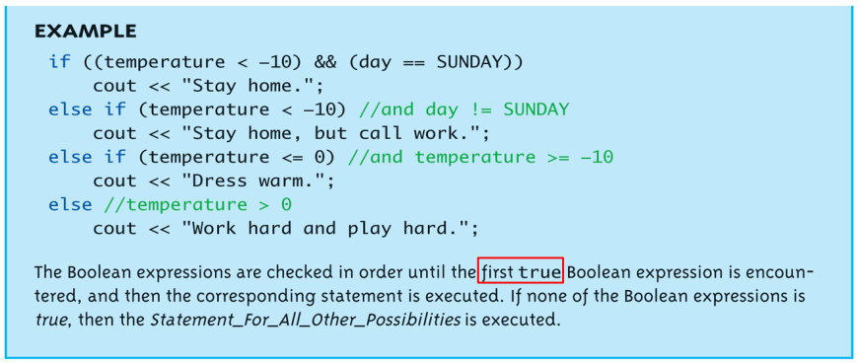
Multiway if-else (2/2)
Example :

Slide 18
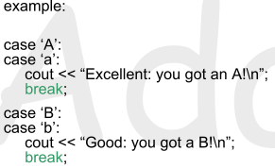
Switch Statement (1/3)
Controlling expression MUST return an integral value
OK: char, int, bool, enum
not OK: float, double, …
Case labels must also be integral values
break and default are optional
Execution “falls thru” until break

Slide 19
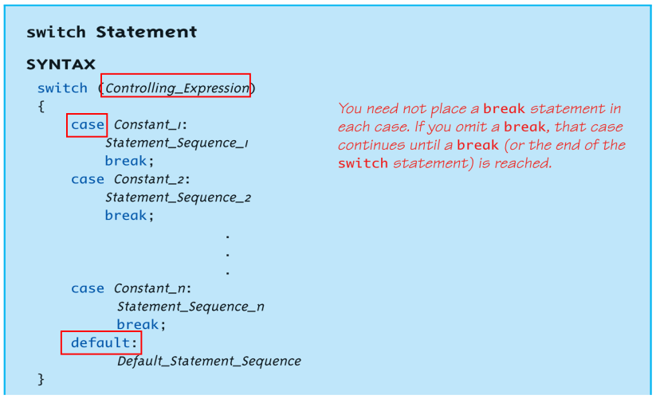
Switch Statement (2/3)
Syntax :

Slide 20
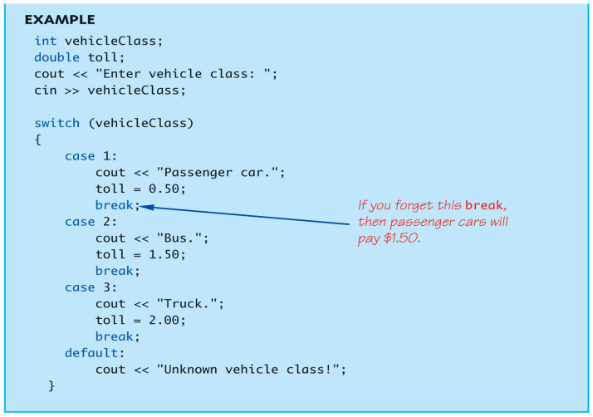
Switch Statement (3/3)
Example :

Slide 21
Loops
3 Types of loops in C++
while
do-while
always enters the loop body at least once
for
appropriate for “counting” loops

Slide 22
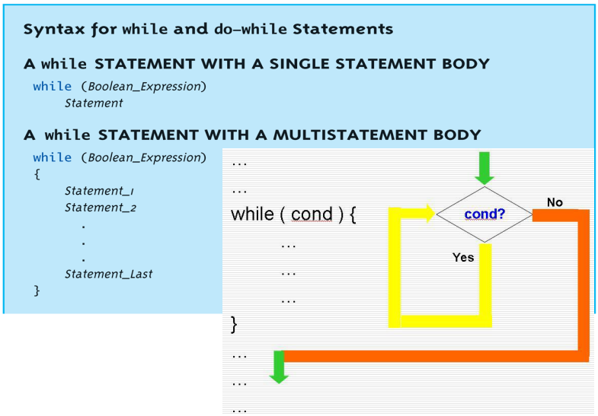
while Loop Syntax

Slide 23
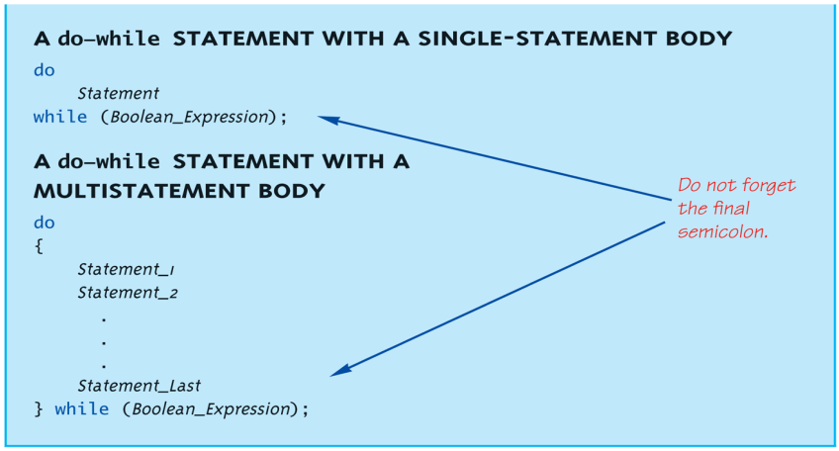
do-while Loop Syntax

Slide 24
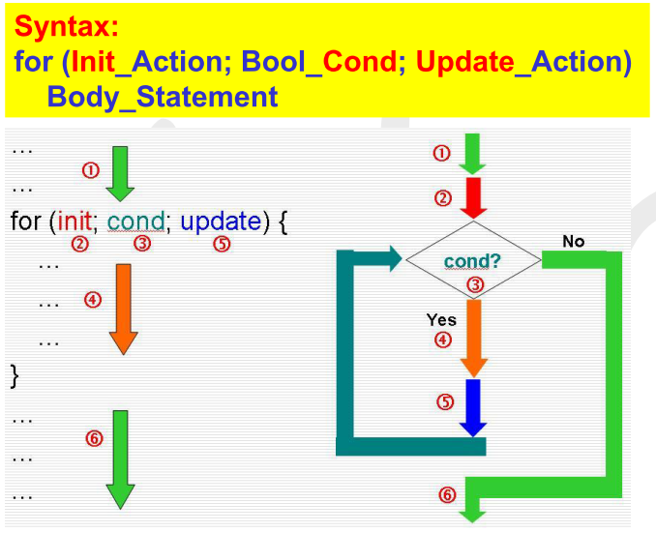
for Loop Syntax

Slide 25
Lab Exercise (1/2)
Write a C++ program such that
it can collect people's age
it can compute the average age of these people
it can compute the number of adults (age≧18)
it will eliminate the negative values and show warning messages
Use unsigned constant to store the legal age
The variables to store the average age should be double type, number of people and number of adults should be unsigned type, so you are asked to use type casting to calculate the mean value of the ages

Slide 26
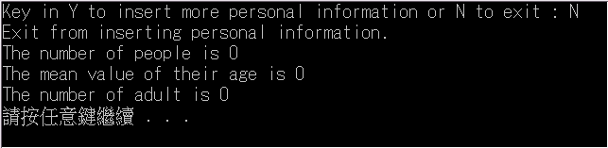
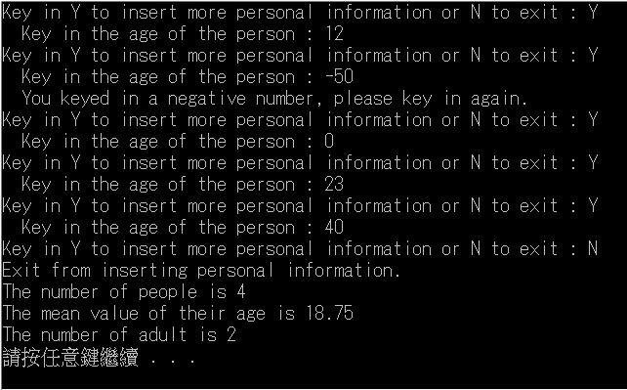
Lab Exercise (2/2)
Example :

